Slide 1
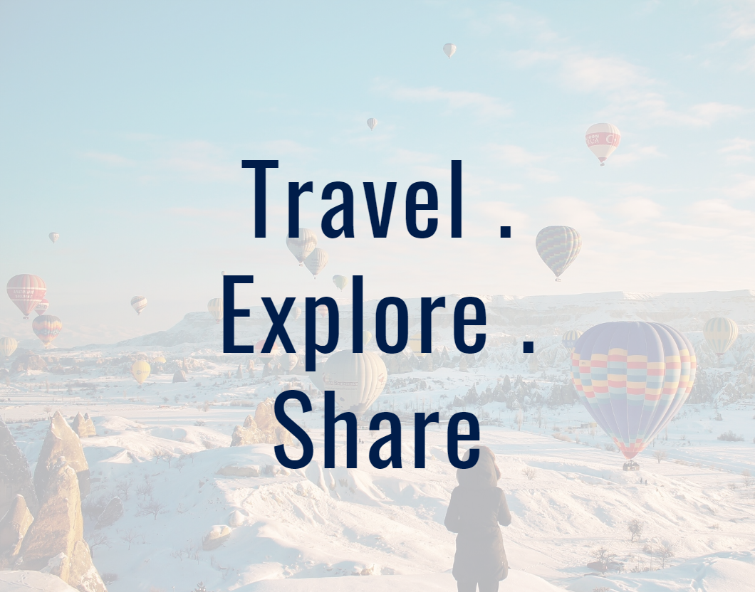
MyEscape a travel blogging website
Ash, Dhanu, Faith, Jomana

Slide 2
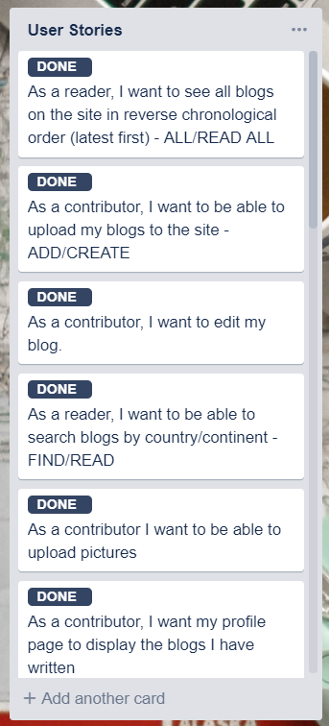
The vision
Why we chose a travel blogging website
What our MVP was
What our broader vision was

Slide 3
How we organised ourselves
Daily standups
Scrum master with estimation
Weekly(ish) sprints
Forward sprints
Reviews and retrospectives
Almost daily hangouts (not prescriptive, based on need) – used for brainstorming, planning and prioritising, allocating tasks, going through code and initial tasks together, problem solving

Slide 4
Project flow
Database creation
Wireframes
Styling
Adding functionality to match high priority user stories
Initial Planning
Understanding and mapping our MVC model
Responsiveness
Presentation
Get code working
Testing, error handling, coding defensively
Making the product more useful
Sprint 1
Sprint 2
Sprint 3
Notes:
Diagram shows the priorities in each sprint
Revolving arrow indicates that it was an Agile process, all elements continuously reviewed and tweaked as necessary for the product – e.g. making database refinements in week 3

Slide 5
What went well
Functional product
Underestimated ourselves, put together something more substantial than our MVP
Team worked well together
Workload evenly distributed
Everybody flexible, understanding, listening and helpful
Stress managed
Pragmatic approach – got on with it
Everyone was reliable
Limited hangout time, more action less talking
Commitment to Trello – tracking what’s being done, by who, when
Organisation and prioritisation – smooth flow of project
How quickly we grasped MVC

Slide 6
Challenges
Dhanu working from India (due to family situation) – heat and different time differences
Health issues
Ash corrupting her database :P
Ash not hearing people on hangouts :P
Team getting the hang of GitHub – using branches, managing conflicts, terminal vs Desktop
Different bootstrap versions
Learning on the job – trying and testing as we went
Slower with CSS/HTML/Javascript than PHP
Balancing life/family/commitments as well

Slide 7
Even better if…
Could we have done anything better? Perhaps could have mapped out styling a bit more beforehand so that we had consistency from the start rather than trying to make it all fit at the end?
All done the same method of github
Notes:
This is with regards to us working up to this point – the next slide covers how we would take the product further

Slide 8
Future of our product
Introducing more security – hashing passwords (we tried), using cookie session IDs to track user, restricting login attempts, password verification via email links
Refactoring code – for efficiency and to reduce redundancy
Functionality – Incorporating our more complex user stories
Capacity to incorporate Twitter and Instagram feeds
Ability to bookmark/save blog posts of interest
An extra layer between posting a blog and it being published whereby an administrator could review the content to make sure that it’s appropriate and legible
Considering accessibility for differently-abled people
Support for other languages

